Slide 1
Rows:
Filter:
Columns:

Slide 2
Data Variation over time:
Add granularity to the analysis:
Compare data across locations:
Compare a total amount divided into parts at a given point in time:

Slide 3
Displays the boundary lines between political entities, such as countries, regions or districts.
Depicts information about a topic or theme over a geographic area
Shows the point coordinate location of facilities with different icons or images to show different categories of facilities, such as health centers, dispensaries or schools

Slide 4
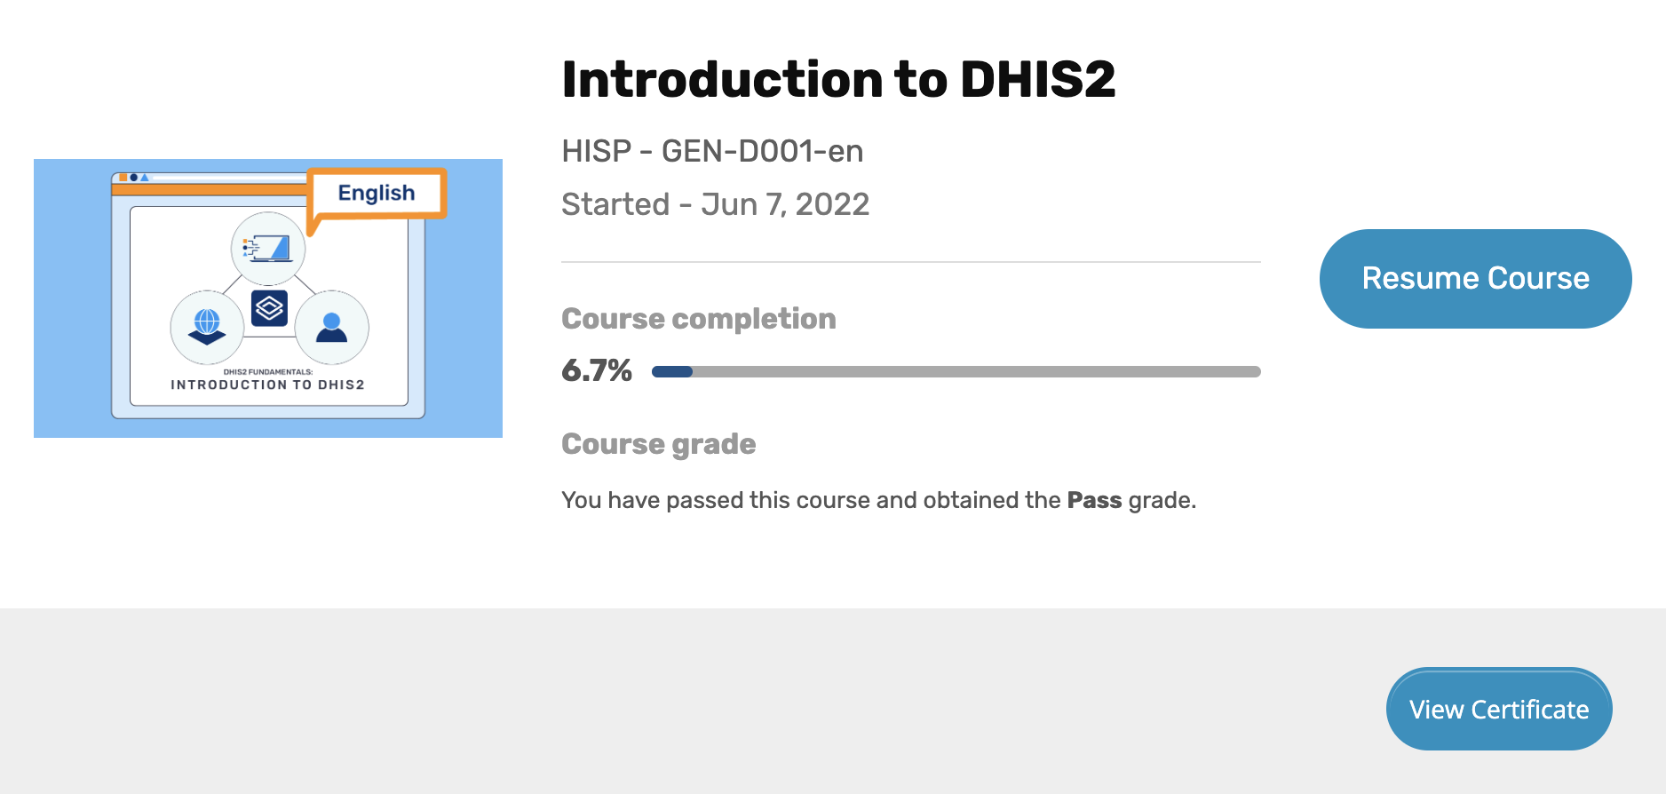
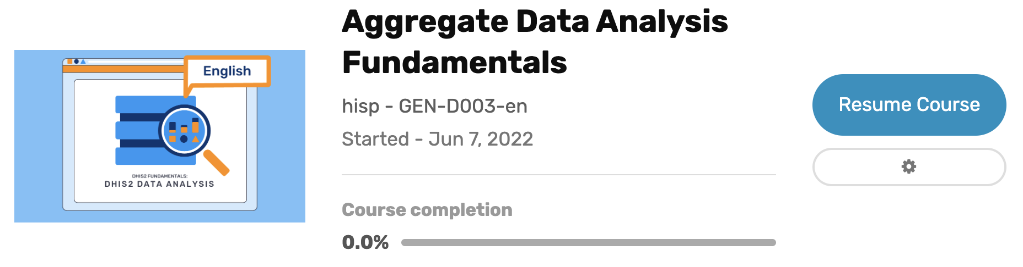
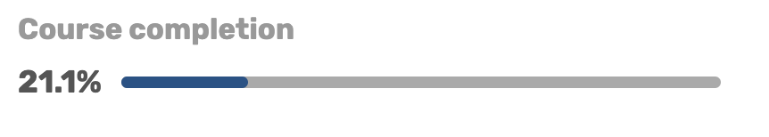
Click here to view and download certificate

